Slide 1
How a DevOps mindset is influencing Target's culture

Slide 2

350,000+ team members
1914 stores (all US based)
46 distribution centers
7 HQ locations
5% Target profit goes to communities
59 years of service
~$93.5B in 2020 revenue
tech.target.com

Slide 3
Organizational Context
CEO
CFO
COO
CGO
… C-Suite
Chief Merchant
SVP Merch Capabilities
SVP Planning
SVP Strategy
… SVP
Brett Craig - SVP, Merch Capabilities
Luke Rettig - Sr Director Product Management, Merch Capabilities
Accountable for all of the capability functions supporting Target’s Merchant Organization including:
Pricing, Promotions, and Clearance
Space, Presentation, and Transitions
Business Partnerships and Negotiations
Small Format Stores and Localization
Product Management
Former SVP of Target Tech for Merchandising, Supply Chain, and Stores
Recently moved to lead Digital
Accountable for Product Management functions within Merch Capabilities for :
Space, Presentation, and Transitions
Assortment Planning
Financial Planning
Merch Insights and Analytics
Former Technical Product Manager for Target Aggregate Data Services and Data Platform and Former Engineering Manager - Supply Chain
Notes:
How the organization helps facilitate the relationships we’re going to talk about

Slide 4
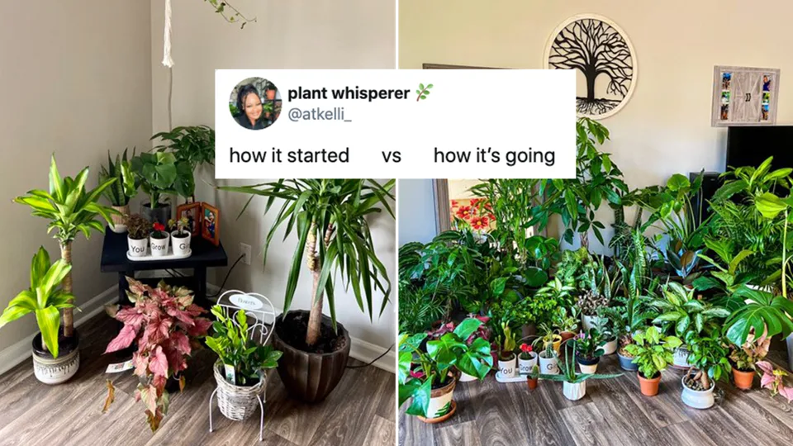
A POV on Target’s Journey

Slide 5
2 Short Stories about Culture Change
Fresh Food Merchandising Revamped - Circa late 2018
COVID Response at TGT - Circa March 2020
Key Themes
Breaking Down Silos
Knowledge Sharing and Feedback Loops
Co-Creation and Trust
Value Chain Mapping
Notes:
User Survey – show of hands
​Separate Technology and Product Roadmaps​
​
Built something that wasn’t used​
… then rebuilt it and wasn’t used again.

Slide 6
Fresh Food Merchandising Revamp

Slide 7
Context
In 2018, Target was in a dire spot in Food and Beverage. Our inability to be in stock on high quality perishables was raising the question of whether or not we should be in this business in 5 years.

Slide 8
Insert FreshOps - a proposed 50+ person team to “fix” Fresh Food and Beverage Merchandising
Notes:
Consulting firm to be left unnamed.
My current boss, who was new at the time to leading our “Capabilities” team was coming in fresh from his role as the SVP of Technology for Merchandising, Stores, and Supply Chain. He said “no way”
Instead, he asked me if I would be willing to lead a lean team to build some sustainable, repeatable capabilities.

Slide 9
What We Did
Clarity from Leaders on the Goal and they got out of our way
Small, Empowered, Cross-Disciplined Team
Guardrail: Drive Profit without sacrificing Sales in Fresh
Merchants, Product, Engineering, Data Analysts Co-Located
Mapped out the Value Stream (Key Milestones, KPIs and Activities)
Used Short Sprints, Fast Feedback Loops, Kanban Boards, and Retros
Notes:
Fresh Categories:
Bakery/Deli
Produce
Fresh Meat

Slide 10
Outcomes
Business Results
Increased Gross Margin by 32% with lost Sales +/- 2%
Decreased Footage Allocation of Fresh Categories by 15%
Built v1 of what is now our Assortment Planning Product suite.
Culture Change
Introduced the business to a new way of working
Trust and co-creation are at the core in F&B
This set the stage for how we wanted to operate.

Slide 11
COVID Response

Slide 12
Pre-COVID Merchandising Culture
Siloed
Snowflake
My Division
Unique
My Category
This Quarter
Merchant Driven
Notes:
WAM - Weekly Action Meeting - Merchandising focused and attended. Was just a koolaid session or a roast.
WOM - Weekly Operations Meeting - SC and Store Focused and attended
Product and Technology teams were just the ‘tech arm’

Slide 13
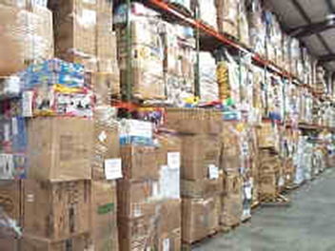
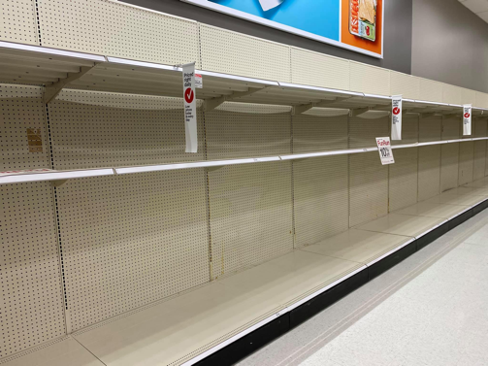
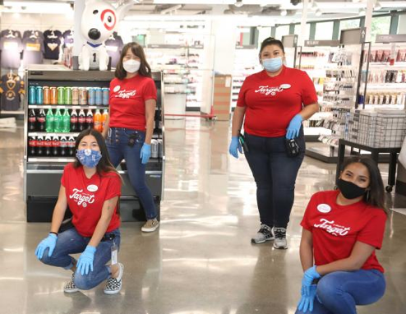
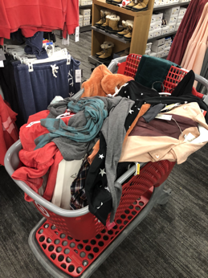
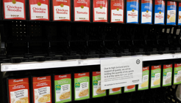
And then...

Slide 14
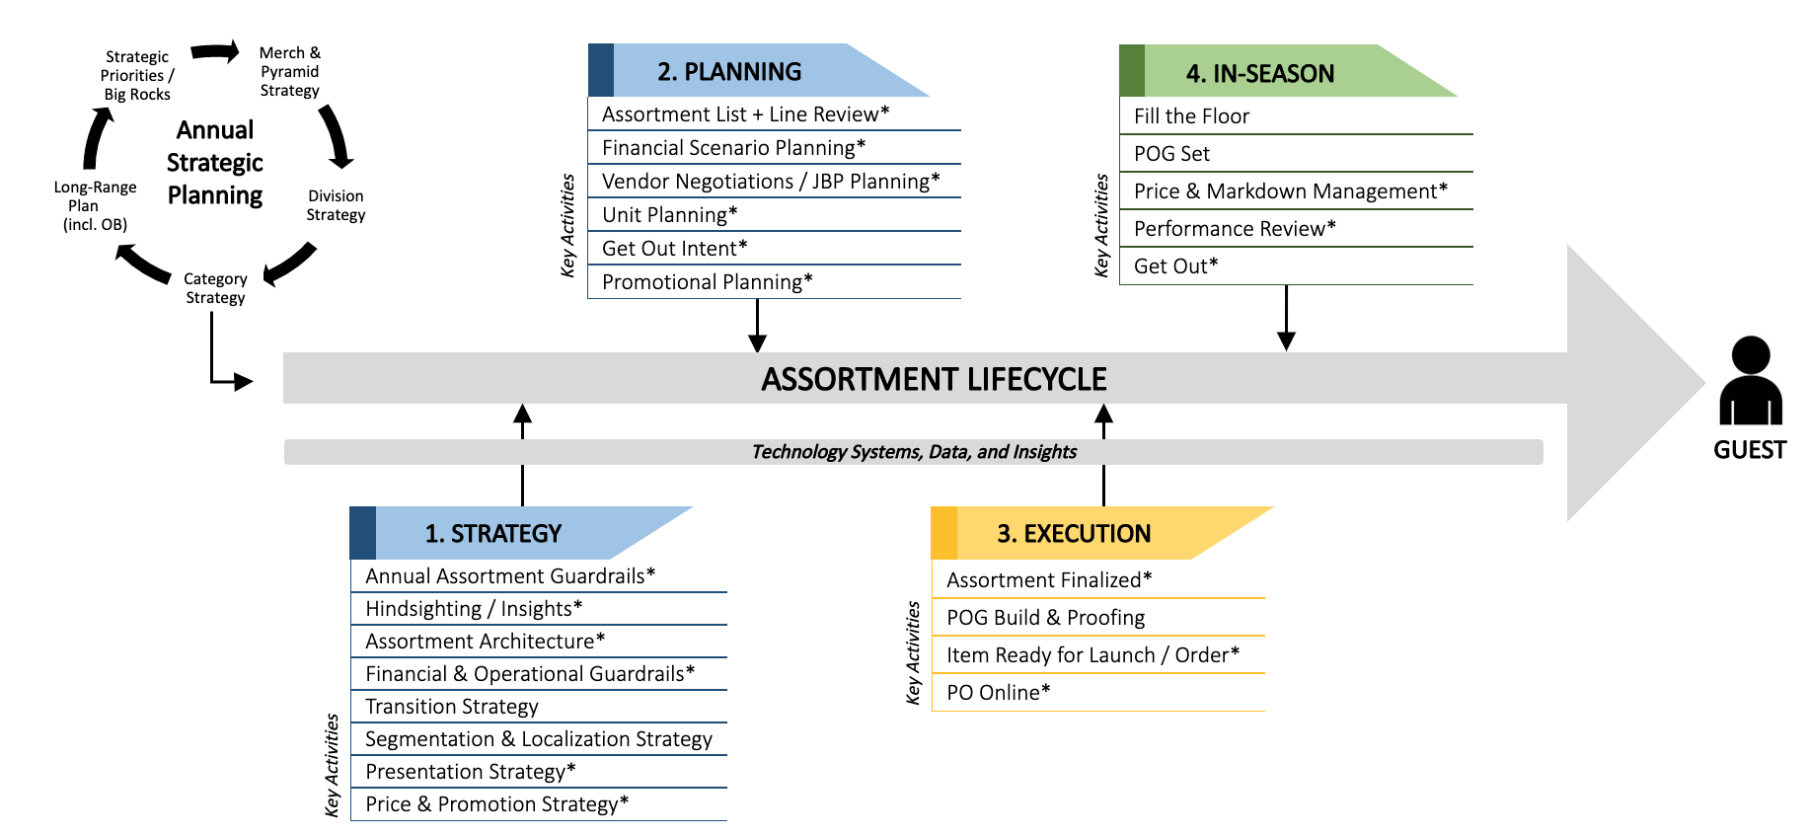
Orienting our Capabilities Team around the Value Chain
Notes:
Being the Product Leader within the Capabilities team, I was uniquely positioned to see the value chain in which Merchandising played.
Coming from Supply Chain, I was able to leverage my Connections across the enterprise to start breaking problems down into workable chunks
We leveraged the newly formed Daily Action meeting to review progress, remove roadblocks and make cross enterprise decisions - with the right people in the room

Slide 15
COVID Revamp: Enterprise Mindset
DAM
Cherish our Field Team Members
What’s Best for Guest
Co-create with Tech
2 year CAGR
Value Chain
Vendor win-win partnerships

Slide 16
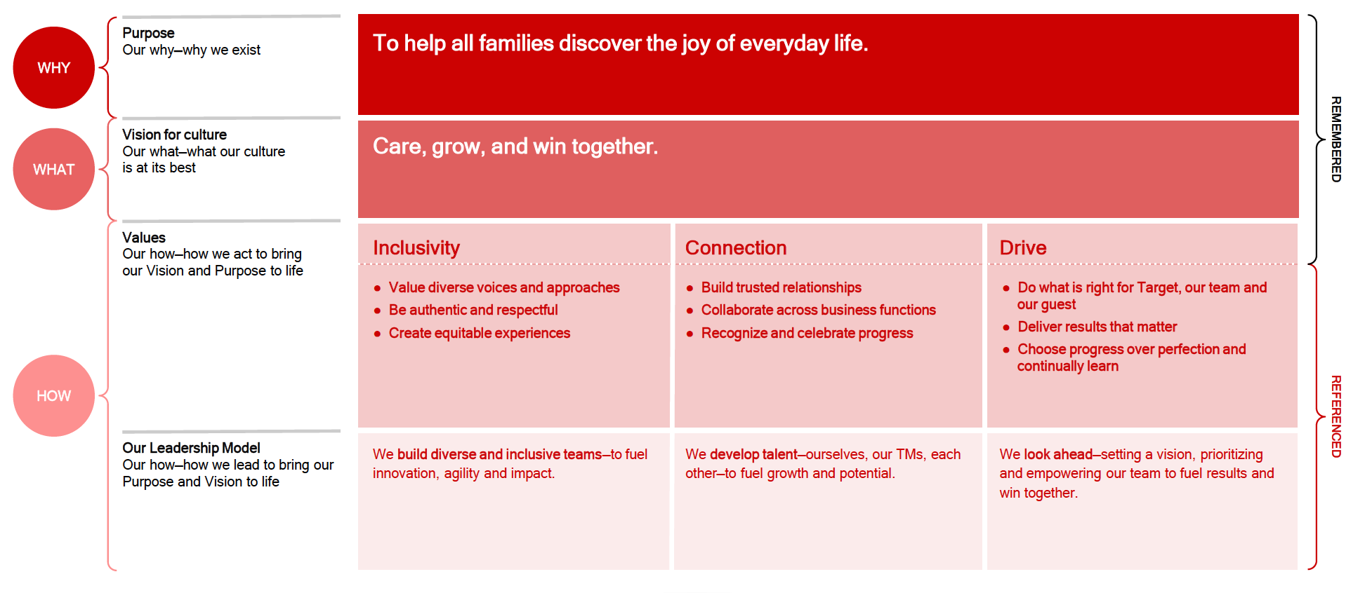
A Telling Outcome

Slide 17
Opportunities That Remain
Product thinking maturation
Tech talent
Continue driving the spirit of DevOps into the organization

